Slide 1
Formalizing Mechanistic Explanations
Proof Size as a Metric for Interpretability
Jason Gross, Special Project @ Alignment Research Center
April 9, 2024
Notes:
Been working on this stuff for eight months, second time I’m presenting any of it.
V. interested in feedback & questions throughout

Slide 2
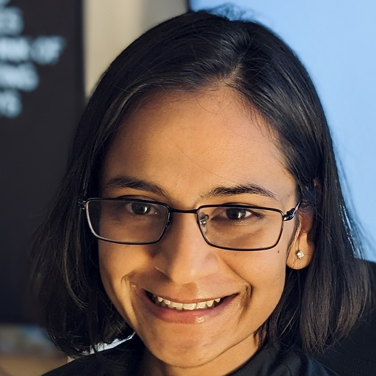
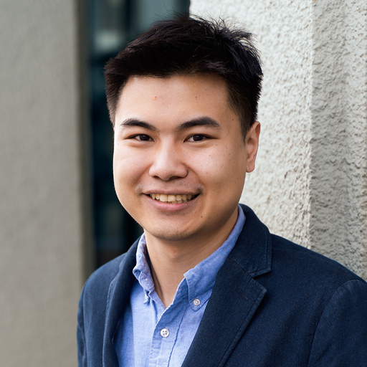
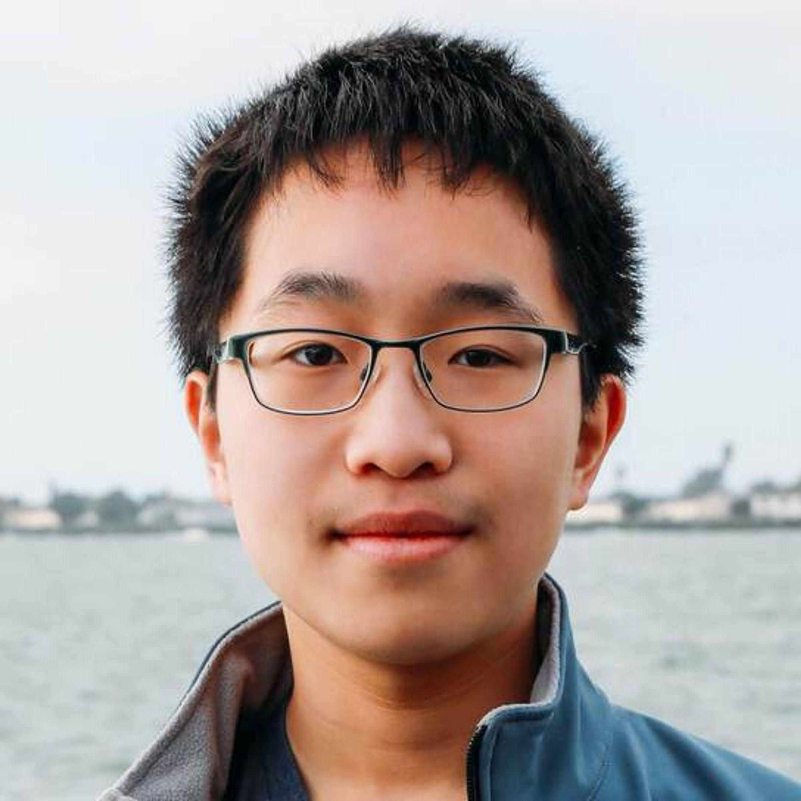
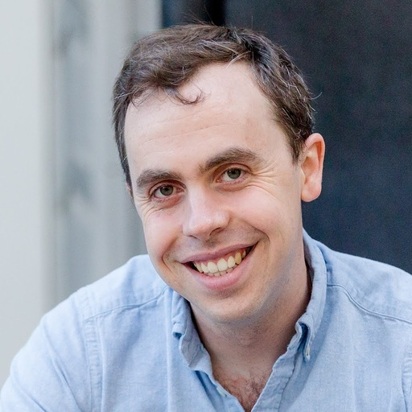
Team
Jason Gross
Rajashree Agrawal
Lawrence Chan
Euan Ong
Thomas Kwa
Chun Hei Yip
Alex Gibson
Soufiane Nourbir
Paul Christiano
(Advisor)

Slide 3
Ambitious Mechanistic Interpretability
Proofs Approach
Case Study: Max of 4
Applications: Modular Arithmetic and SAEs
This talk in three bullet points
Motivation: Suppose we got AGI tomorrow, can we build a trustworthy, automated pipeline for discovering mechanistic explanation of model behavior?
We demonstrate explanations of the highest standard of trustworthiness: Via formal proofs
We explore the fundamental question: Is compressing unstructured noise even possible?

Slide 4
Ambitious Mechanistic Interpretability
Proofs Approach
Case Study: Max of 4
Applications: Modular Arithmetic and SAEs
Desiderata for mechanistic explanations
What do we need for ambitious applications of mech interp: catching deception, MAD, ELK, backdoor detection, …?
Explanation actually corresponds to model mechanisms
Not cherry-picked evidence
Adversarially robust
Explanation compresses model behavior / is rich in insight
Permits reasoning about generalizing behavior
Is necessary for scaling with model size
Notes:
My motivation for poking into the internals of models is the ambitious applications that need understanding of internals. and I’m a programming languages guy, so I know how hard verification is

Slide 5
Ambitious Mechanistic Interpretability
Proofs Approach
Case Study: Max of 4
Applications: Modular Arithmetic and SAEs
Correspondence to model w/o compression
Consider the brute-force explanation of some behavior:
“I ran the model” i.e., here is the trace of the model computation on all relevant inputs
100% corresponds to model mechanisms!
100% unsatisfying!
100% does not scale in model size!
100% useless for ambitious applications!

Slide 6
Ambitious Mechanistic Interpretability
Proofs Approach
Case Study: Max of 4
Applications: Modular Arithmetic and SAEs
Correspondence and compression
Formalizing mechanistic interpretability with proofs would offer a way to track and optimize for both correspondence and compression:
Valid proofs correspond to their object of study
Compression ∝ 1/(description length of formal proof)
Maybe we should try it!
https://www.svgrepo.com/svg/29028/gzip-file-format-variant
https://calebstanford.com/2019/01/15/coq-vector-image/
Notes:
… [next slide] The rest of this talk is about the proofs approach

Slide 7
Ambitious Mechanistic Interpretability
Proofs Approach
Case Study: Max of 4
Applications: Modular Arithmetic and SAEs
Compression game
Consider theorems that a particular model M achieves a certain level of performance:
Goal: minimize proof length (in any formal system) for fixed b; or: maximize b for fixed proof length
Notes:
The rest of this talk is about the proofs approach…
the expectation of its performance score is bounded below by some b
Really we can use any formal system and measure proof-checking time.

Slide 8
Ambitious Mechanistic Interpretability
Proofs Approach
Case Study: Max of 4
Applications: Modular Arithmetic and SAEs
Proof length
Theorem:
Our proofs consist of two components:
Proof that a particular computation C, when run with any model’s weights, produces a valid bound on that model’s performance
A trace of running C proving that C(M) = b
In practice, proof length will be dominated by (2)
Notes:
Really we can use any formal system and measure proof-checking time.
In practice, proof length is going to be dominated by the trace of C, which needs to include all the weights of the model written out, at a bare minimum.

Slide 9
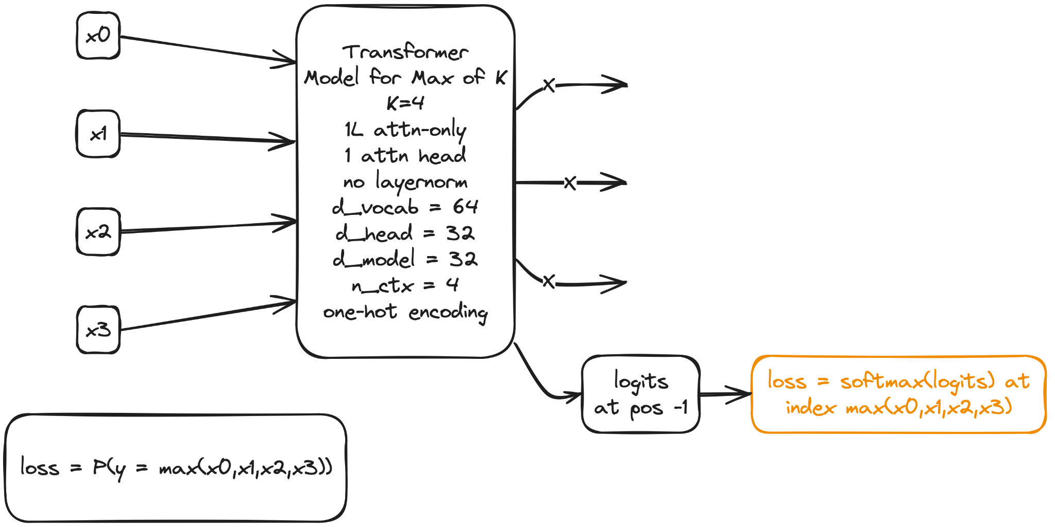
Ambitious Mechanistic Interpretability
Proofs Approach
Case Study: Max of 4
Applications: Modular Arithmetic and SAEs
Case study: Max of K
Notes:
We tried the proofs approach. I will convey our results using a toy model.
Diagram made with https://excalidraw.com/, saved here, current version saved here
graph LR
x0(x0) --> model("Transformer
Model
K=4
1L attn-only
1 attn head
no layernorm
d_vocab = 64
d_head = 32
d_model = 32
n_ctx = 4
one-hot encoding")
x1(x1) --> model
x2(x2) --> model
x3(x3) --> model
model -->|X| a:::hidden
model -->|X| b:::hidden
model -->|X| c:::hidden
model --> logits("logits
at pos -1")
logits --> loss("loss = softmax(logits) at
index max(x0,x1,x2,x3)")
style a stroke:#f000
style b stroke:#f000
style c stroke:#f000
style loss stroke:#F7AE49
loss2("loss
=
P(y = max(x0,x1,x2,x3))")
*********
Accuracy:argmax(model(xs)[-1]) == max(xs)
Loss:softmax(model(xs)[-1])[max(xs)]
model([40,62,3,0]) == [[_, _, _, [-10, -16, -18, …, 16.8, 32.6, 0.6]]] (position 62 = 64 - 2)

Slide 10
Ambitious Mechanistic Interpretability
Proofs Approach
Case Study: Max of 4
Applications: Modular Arithmetic and SAEs
Brute Force Proof Sketch
Theorem:
Computation C:
def C(M):
count = 0
for x in possible_sequences:
count+=(M(x)[..., -1, :].argmax(dim=-1) == x.max(dim=-1).values).sum().item()
return count / len(possible_sequences)
Lemma: C produces a valid bound. Proof. Exercise
Lemma: C(M) = .9973 Proof: By computation.
Notes:
Let me walk you through an example proof
$(W_E + W_{\text{pos}}[-1])\frac{W_QW_K^T}{\sqrt{d_{\text{head}}}}(W_E + \mathbb{E}_pW_{\text{pos}}[p])^T$ here
$$(W_E + \mathbb{E}_pW_\text{pos}[p])W_VW_OW_U$$ here

Slide 11
Ambitious Mechanistic Interpretability
Proofs Approach
Case Study: Max of 4
Applications: Modular Arithmetic and SAEs
Attend More to Bigger Tokens & Copy
Attention Score
Attention Computation
Notes:
$(W_E + W_{\text{pos}}[-1])\frac{W_QW_K^T}{\sqrt{d_{\text{head}}}}(W_E + \mathbb{E}_pW_{\text{pos}}[p])^T$ here
$$(W_E + \mathbb{E}_pW_\text{pos}[p])W_VW_OW_U$$ here

Slide 12
Ambitious Mechanistic Interpretability
Proofs Approach
Case Study: Max of 4
Applications: Modular Arithmetic and SAEs
Results: Proof Size vs. Tightness of Bound
Description of Proof | Complexity Cost Budget | Bound
Brute force | Exponential: d_vocab^{n_ctx}n_ctx d_vocab d_model | 99.73%
Convexity of Softmax | Cubic: d_vocab³n_ctx² | 98.4%
Sub-cubic | d_vocab²n_ctx² + d_vocab²d_model | 54.5% – 56.9%
low-rank avg+diff on EU, QK | d_vocab²n_ctx² + d_vocab d_model² + (OV only) d_vocab²d_model | 48.9% – 54.8% (27.8% – 33.2% if via SVD)
Convex Hull on OV (WIP) | d_vocab²n_ctx² + d_vocab d_model² | WIP
Notes:
Red-teaming

Slide 13
Ambitious Mechanistic Interpretability
Proofs Approach
Case Study: Max of 4
Applications: Modular Arithmetic and SAEs
Red-Teaming Cubic Proof
Insight: There is a single token we want to be paying attention to (the max)
Convexity of Softmax:
(max token, non-max token) ⇒ score of (how bad it is to pay attention to, how much attention is paid to it for each fixed query token)
(max token, query token) ⇒ sort non-max tokens by a combined score
If model succeeds when all non-max non-query tokens are A, it also succeeds when tokens are better than A.
Modulo handling positional encodings, this allows us to run the model on only d_vocab³ sequences instead of d_vocab⁴.
Notes:
Code C for this proof, despite running in less time and having a shorter trace, is significantly more complicated than for the brute force proof, [next slide]
Score = d/dn (n e^alpha v_A + (k-n) e^(alpha_max) v_max) / (n e^alpha + (k-n) e^(alpha_max))

Slide 14
Ambitious Mechanistic Interpretability
Proofs Approach
Case Study: Max of 4
Applications: Modular Arithmetic and SAEs
Convexity in PyTorch Code
@torch.no_grad()
def compute_largest_wrong_logit_cubic(
extreme_softmaxed_right_attention: Float[
Tensor,
"minmax=2 attn=3 d_vocab_q d_vocab_max d_vocab_nonmax n_ctx_copies_nonmax", # noqa: F722
],
*,
EUPU: Float[Tensor, "d_vocab_q d_vocab_out"], # noqa: F722
EVOU: Float[Tensor, "d_vocab_k d_vocab_out"], # noqa: F722
PVOU: Float[Tensor, "n_ctx d_vocab_out"], # noqa: F722
# permitted_nonmax_tokens: Optional[Bool[
# Tensor, "d_vocab_q d_vocab_max d_vocab_nonmax n_ctx_nonmax_copies" # noqa: F722
# ]] = None,
) -> Float[
Tensor, "d_vocab_q d_vocab_max d_vocab_nonmax n_ctx_nonmax_copies" # noqa: F722
]:
r"""
Computes the largest difference between the wrong logit and the right logit for each query token, max token, nonmax
token, and number of copies of the non-max token.
Complexity: O(d_vocab^3 * n_ctx^2)
Preconditions:
extreme_softmaxed_right_attention satisfies the postcondition of compute_extreme_softmaxed_right_attention_cubic_simple
(a lower bound on the post-softmax attention paid to the max token and the query token,
by each possible value of the query token,
for each possible value of the max token,
for each possible value of the non-max token,
for each number of copies of the non max token)
EUPU = (W_E + W_pos[-1]) @ W_U
EVOU = W_E @ W_V @ W_O @ W_U
PVOU = W_pos @ W_V @ W_O @ W_U
Postconditions:
\forall q, m, k, n_copies_nonmax, x:
if q > m or k > m: return[q, m, k, n_copies_nonmax] = nan
elif m = k and n_copies_nonmax != 0: return[q, m, m, n_copies_nonmax] = nan
elif m != k and n_copies_nonmax == 0: return[q, m, k, 0] = nan
elif q != m and n_copies_nonmax >= n_ctx - 1: return[q, m, k, n_copies_nonmax] = nan
(That is, in these cases, the answer is undefined because the query token is greater than the max token, or
there isn't enough room for the non-max token or the max token in the sequence.)
else: for all sequences with query q, max token m, n_copies_nonmax [non-query] copies of k (and the rest of
the non-query tokens equal to m), we have:
return[q, m, k, n_copies_nonmax] <= model(sequence)[-1, x] - model(sequence)[-1, m]
That is, we return a lower bound on the difference between the wrong logit and the right logit for this
combination of query token, max token, non-max token, and number of copies of the non-max token.
The main idea here is that by pessimizing over the positional attention independently of the embedding attention, we can
later use a convexity argument for the embedding attention.
"""
# if permitted_nonmax_tokens is None:
# permitted_nonmax_tokens = torch.ones_like(min_softmaxed_right_attention[0], dtype=torch.bool)
results = torch.zeros_like(
extreme_softmaxed_right_attention[0, 0, :, :, :, :]
) + float("nan")
_, _, d_vocab, _, _, n_ctx = extreme_softmaxed_right_attention.shape
w_max = 0
w_nmx = 1
w_qry = 2
for max_tok in range(d_vocab):
# center PVOU according to max token, O(d_vocab * n_ctx)
PVOU = PVOU - PVOU[:, max_tok].unsqueeze(-1)
# center EUPU according to max token, O(d_vocab^2)
EUPU = EUPU - EUPU[:, max_tok].unsqueeze(-1)
# center EVOU according to max token, O(d_vocab^2)
EVOU = EVOU - EVOU[:, max_tok].unsqueeze(-1)
# to make convexity go through, we need to consider a larger region of phase space bounded by points where
# positional attention is independent of token attention.
# Here we pessimize over positional attention, assuming that we pay 100% of attention to the worst position
PVOU_pessimized: Float[Tensor, "d_vocab_out"] = PVOU.max( # noqa: F821
dim=0
).values
# handle the case with only the max token
logits_only_max: Float[Tensor, "d_vocab_out"] = ( # noqa: F821
EUPU[max_tok, :] + EVOU[max_tok, :] + PVOU_pessimized
)
logits_only_max -= logits_only_max[max_tok].item()
logits_only_max[max_tok] = float(
"-inf"
) # so we can max the logits across the non-max tokens
results[max_tok, max_tok, max_tok, 0] = logits_only_max.max().item()
# now handle the cases with only the query token and n_ctx - 1 copies of the max token
for q_tok in range(max_tok):
cur_extreme_right_attention = extreme_softmaxed_right_attention[
:, :, q_tok, max_tok, max_tok, 0
]
# N.B. because EVOU[q_tok, max_tok] == 0 by centering above, we just take the maximum attention paid to the query
logits_only_q_and_max: Float[
Tensor, "minmax=2 d_vocab_out" # noqa: F722
] = (
EUPU[q_tok, :]
+ PVOU_pessimized
+ EVOU[max_tok, :] * cur_extreme_right_attention[:, w_max].unsqueeze(-1)
+ EVOU[q_tok, :] * cur_extreme_right_attention[:, w_qry].unsqueeze(-1)
)
logits_only_q_and_max -= logits_only_q_and_max[:, max_tok].unsqueeze(-1)
logits_only_q_and_max[:, max_tok] = float("-inf")
results[q_tok, max_tok, max_tok, 0] = logits_only_q_and_max.max().item()
# precompose pessimization for EUPU over output logit, so we have enough compute budget
EUPU_tmp: Float[Tensor, "d_vocab_q d_vocab_out"] = ( # noqa: F722
EUPU.detach().clone()
)
EUPU_tmp[:, max_tok] = float("-inf")
EUPU_per_query_pessimized: Float[Tensor, "d_vocab_q"] = EUPU_tmp.max(
dim=-1
).values # noqa: F821
# Ditto for EVOU
# distribute PVOU over EVOU, to avoid premature pessimization
# TODO: mean+diff
EPVOU_tmp: Float[Tensor, "d_vocab_k d_vocab_out"] = ( # noqa: F722
EVOU + PVOU_pessimized
)
EPVOU_tmp[:, max_tok] = float("-inf")
EPVOU_per_key_pessimized: Float[Tensor, "d_vocab_k"] = ( # noqa: F821
EPVOU_tmp.max(dim=-1).values
)
# now handle the cases with at least one non-max non-query token
for nonmax_tok in range(max_tok):
for n_copies_nonmax in range(1, n_ctx):
# distribute PVOU over EVOU, to avoid premature pessimization
# pessimize over the thing we're not supposed to be paying attention to (w.r.t. the token that is non-max that we're paying attention)
# maximum added to the wrong logit from paying attention to the wrong thing
wrong_attention_logits: Float[Tensor, ""] = ( # noqa: F72
EPVOU_per_key_pessimized[nonmax_tok]
)
# pessimize also over the thing we are paying attention to
right_attention_wrong_logits: Float[Tensor, ""] = ( # noqa: F722
EPVOU_per_key_pessimized[max_tok]
)
for q_tok in range(max_tok + 1):
if q_tok != max_tok and n_copies_nonmax >= n_ctx - 1:
continue
query_wrong_logits: Float[Tensor, ""] = ( # noqa: F722
EPVOU_per_key_pessimized[q_tok]
)
right_attn = extreme_softmaxed_right_attention[
:, w_max, q_tok, max_tok, nonmax_tok, n_copies_nonmax
]
q_attn = extreme_softmaxed_right_attention[
:, w_qry, q_tok, max_tok, nonmax_tok, n_copies_nonmax
]
wrong_attn = extreme_softmaxed_right_attention[
:, w_nmx, q_tok, max_tok, nonmax_tok, n_copies_nonmax
]
results[q_tok, max_tok, nonmax_tok, n_copies_nonmax] = (
EUPU_per_query_pessimized[q_tok]
+ (
right_attn * right_attention_wrong_logits
+ q_attn * query_wrong_logits
+ wrong_attn * wrong_attention_logits
).max()
).item()
return results
@torch.no_grad()
def compute_extreme_softmaxed_right_attention_cubic_simple(
EQKE: Float[Tensor, "d_vocab_q d_vocab_k"], # noqa: F722
EQKP: Float[Tensor, "d_vocab_q n_ctx_k"], # noqa: F722
attn_scale: Union[Float[Tensor, ""], float] = model.blocks[ # noqa F722
0
].attn.attn_scale,
position: Optional[int] = None,
) -> Float[
Tensor,
"minmax=2 attn=3 d_vocab_q d_vocab_max d_vocab_nonmax n_ctx_copies_nonmax", # noqa: F722
]:
r"""
Computes the extreme (min-attn-to-max is minmax=0, max-attn-to-max is minmax=1) post-softmax attention (extremized over sequence orderings) paid to the maximum token (attn=0) and
to the non-maximum token (attn=1) and to the query token (attn=2):
- by each possible value of the query token,
- for each possible value of the max token,
- for each possible value of the nonmax token,
- for each number of copies of the non max token
Basically, this attempts to lower bound the attention that is paid to the max token and the query token, by
pessimising over the order of the non-query tokens.
Note that we could do a bit of a better job than this by taking in min_gap and a pre-computed extreme_attention
matrix, if we wanted to.
Time Complexity: O(d_vocab^3 * n_ctx^2)
Preconditions:
. attn_scale is correct for the model (\sqrt(d_head) by default)
. EQKE[q, k] is the attention paid from query q to key token k
. EQKP[q, p] is the attention paid from query q to key position p
Postconditions:
\forall w \in {0,1,2}, q, m, k, n_copies_nonmax: ("w" for which)
if q > m or k > m: return[:, w, q, m, k, n_copies_nonmax] = nan
(That is, the answer is undefined if the query token is greater than the max token, or if the non-max
token is greater than the max token)
elif m = k and n_copies_nonmax != 0: return[:, w, q, m, k, n_copies_nonmax] = nan
(That is, the answer is undefined if the non-max token is equal to the max token and there are non-zero
copies of non-max tokens)
elif q != m and n_copies_nonmax >= n_ctx - 1: return[:, w, q, m, k, n_copies_nonmax] = nan
(That is, the answer is undefined if the query token is not equal to the max token and there are n_ctx
- 1 or more copies of the non-max token, because then the max token would be missing)
else: amongst all permutations of [the non-query-tokens in] the sequence with query q, n_copies_nonmax copies
of k, and all other tokens equal to m:
return[0, 0, q, m, k, n_copies_nonmax] <= post-softmax attention paid to max token m <= return[1, 0, q, m, k, n_copies_nonmax]
return[0, 1, q, m, k, n_copies_nonmax] <= post-softmax attention paid to non-max token k <= return[1, 1, q, m, k, n_copies_nonmax]
return[0, 2, q, m, k, n_copies_nonmax] <= post-softmax attention paid to query token q <= return[1, 2, q, m, k, n_copies_nonmax]
"""
d_vocab, n_ctx = EQKE.shape[-1], EQKP.shape[-1]
result = torch.zeros((2, 3, d_vocab, d_vocab, d_vocab, n_ctx)).to(EQKE) + float(
"nan"
)
tmp = torch.zeros(
(
2,
n_ctx,
)
).to(EQKE)
# constants for indices so we don't have 0 and 1 floating around
w_max = 0
w_nmx = 1
w_qry = 2
# we sort EQKP so that higher-attention positions are at the back, so we can put the max token at the front.
EQKP, EQKPm1 = EQKP[:, :-1].sort(dim=-1).values, EQKP[:, -1]
for max_tok in tqdm(range(d_vocab), desc="max_tok", position=position):
for q_tok in range(max_tok + 1):
tmp[:, -1] = EQKE[q_tok, q_tok] + EQKPm1[q_tok]
for k_tok in range(max_tok + 1):
if k_tok == max_tok:
if q_tok == max_tok:
# only max tok, so we pay 100% attention to it
result[:, w_max, q_tok, max_tok, k_tok, 0] = 1
result[:, w_nmx, q_tok, max_tok, k_tok, 0] = 0
result[:, w_qry, q_tok, max_tok, k_tok, 0] = 0
continue
tmp[:, :-1] = EQKP[q_tok] + EQKE[q_tok, k_tok]
tmp_sm = (tmp / attn_scale).softmax(dim=-1)
result[:, w_max, q_tok, max_tok, k_tok, 0] = tmp_sm[:, :-1].sum(
dim=-1
)
result[:, w_nmx, q_tok, max_tok, k_tok, 0] = 0
result[:, w_qry, q_tok, max_tok, k_tok, 0] = tmp_sm[:, -1]
continue
for n_copies_nonmax in range(n_ctx):
n_copies_max_nonquery = n_ctx - n_copies_nonmax - 1
if q_tok != max_tok and n_copies_nonmax >= n_ctx - 1:
continue
tmp[0, :-1] = EQKP[q_tok]
tmp[1, :-1] = EQKP[q_tok].flip(dims=[0])
tmp[:, :n_copies_max_nonquery] += EQKE[q_tok, max_tok]
# attention paid to non-max tokens other than in the query position
tmp[:, n_copies_max_nonquery:-1] += EQKE[q_tok, k_tok]
tmp_sm = (tmp / attn_scale).softmax(dim=-1)
result[:, w_max, q_tok, max_tok, k_tok, n_copies_nonmax] = tmp_sm[
:, :n_copies_max_nonquery
].sum(dim=-1) + (tmp_sm[:, -1] if q_tok == max_tok else 0)
result[:, w_nmx, q_tok, max_tok, k_tok, n_copies_nonmax] = result[
:, w_qry, q_tok, max_tok, k_tok, n_copies_nonmax
] = (tmp_sm[:, -1] if q_tok != max_tok else 0)
return result
@torch.no_grad()
def count_correct_sequences_cubic(
largest_wrong_logit: Float[
Tensor, "d_vocab_q d_vocab_max d_vocab_nonmax n_ctx_nonmax_copies" # noqa: F722
],
) -> int:
d_vocab_q, d_vocab_max, d_vocab_nonmax, n_ctx = largest_wrong_logit.shape
correct_count = 0
for q_tok in range(d_vocab_q):
for max_tok in range(d_vocab_max):
for n_copies_nonmax in range(n_ctx):
if q_tok > max_tok or (
q_tok != max_tok and n_copies_nonmax >= n_ctx - 1
):
continue
if n_copies_nonmax == 0:
correct_count += 1
else:
cur_largest_wrong_logit = largest_wrong_logit[
q_tok, max_tok, :max_tok, n_copies_nonmax
] # consider wrong logits only when non-max token is less than max token
num_nonmax_tok_choices = cur_largest_wrong_logit[
~cur_largest_wrong_logit.isnan() & (cur_largest_wrong_logit < 0)
].size(0)
cur_count = count_sequences(
n_ctx - 1, n_copies_nonmax, num_nonmax_tok_choices
)
if n_copies_nonmax > 0 and max_tok == 0:
assert (
cur_count == 0
), f"count: {cur_count} == count_sequences({n_ctx - 1}, {n_copies_nonmax}, {num_nonmax_tok_choices})"
else:
max_possible_count = max_tok**n_copies_nonmax * math.comb(
n_ctx - 1, n_copies_nonmax
)
assert (
cur_count <= max_possible_count
), f"count: {cur_count} == count_sequences({n_ctx - 1}, {n_copies_nonmax}, {num_nonmax_tok_choices}) > {max_possible_count}"
# cur_largest_wrong_logit < 0 -> the model gets it right (and the non-nan just ensures its valid)
# N.B. Here, n_copies_nonmax does NOT include the query token
correct_count += cur_count
# consider the space where there's one dimension for each input token that controls "do we use this or not"
# we consider a subspace where "did the model get it right" is convex in this space
# i.e. if you get it for non-max token = x and non-max token = y, you get it for all sequences
# that contain any combination of x and y (note that there can only be 1, 2, or 3 non-max tokens in
# the sequence (where 3 occurs only when the query token is the max token))
# You can extend this to 3 non-max token choices by induction
return correct_count
def compute_accuracy_lower_bound_from_cubic(
largest_wrong_logit: Float[
Tensor, "d_vocab_q d_vocab_max d_vocab_nonmax n_ctx_nonmax_copies" # noqa: F722
],
) -> Tuple[float, Tuple[int, int]]:
"""
returns correct_count / total_sequences, (correct_count, total_sequences)
"""
d_vocab_q, d_vocab_max, _, n_ctx = largest_wrong_logit.shape
correct_count = count_correct_sequences_cubic(largest_wrong_logit)
total_sequences = d_vocab_max**n_ctx
return correct_count / total_sequences, (correct_count, total_sequences)

Slide 15
Ambitious Mechanistic Interpretability
Proofs Approach
Case Study: Max of 4
Applications: Modular Arithmetic and SAEs
Red-Teaming Sub-cubic Proof
Insight: QK attention dominates OV
“badness” ordering of tokens is largely independent of max token
we can do a (slow) proof search procedure to determine “gap size” (max - largest non-max)
for each query & max, we can use gap to bound how much attention we pay to non-max tokens
we then must independently pick which token is worst to pay attention to (combined score is too expensive to compute exactly)

Slide 16
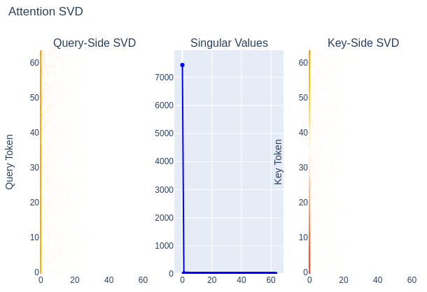
Ambitious Mechanistic Interpretability
Proofs Approach
Case Study: Max of 4
Applications: Modular Arithmetic and SAEs
Red-Teaming d_vocab²d_model ⇒ d_vocab d_model²
Attention Score

Slide 17
Ambitious Mechanistic Interpretability
Proofs Approach
Case Study: Max of 4
Applications: Modular Arithmetic and SAEs
Limitation: Noise
×
×
×
=
max row diff ≈ 1.85 How???

Slide 18
Ambitious Mechanistic Interpretability
Proofs Approach
Case Study: Max of 4
Applications: Modular Arithmetic and SAEs
SVD to handle noise
×
×
×
×
×
×
×
×
=
=
×
√2 · σ₁ ≈ 4√2 × √2 · σ₁ ≈ 1.4√2 × √2 · σ₁ ≈ 1.4√2 × √2 · σ₁ ≈ 4√2 ≈ 30√2 ≈ 43 ≥ 10.7
×
×
×
≈
max row diff ≈ 1.85
2 · max abs value ≈ 2
√2 · σ₁ ≈ 7.6√2 ≈ 10.7
Even lower complexity bound:
Frobenius norm: 10 × 4 × 4 × 10 √2 ≈ 1932 √2 ≈ 2732(!)
(best bound with another ~SVD-complexity method: ≈ 5.67)

Slide 19
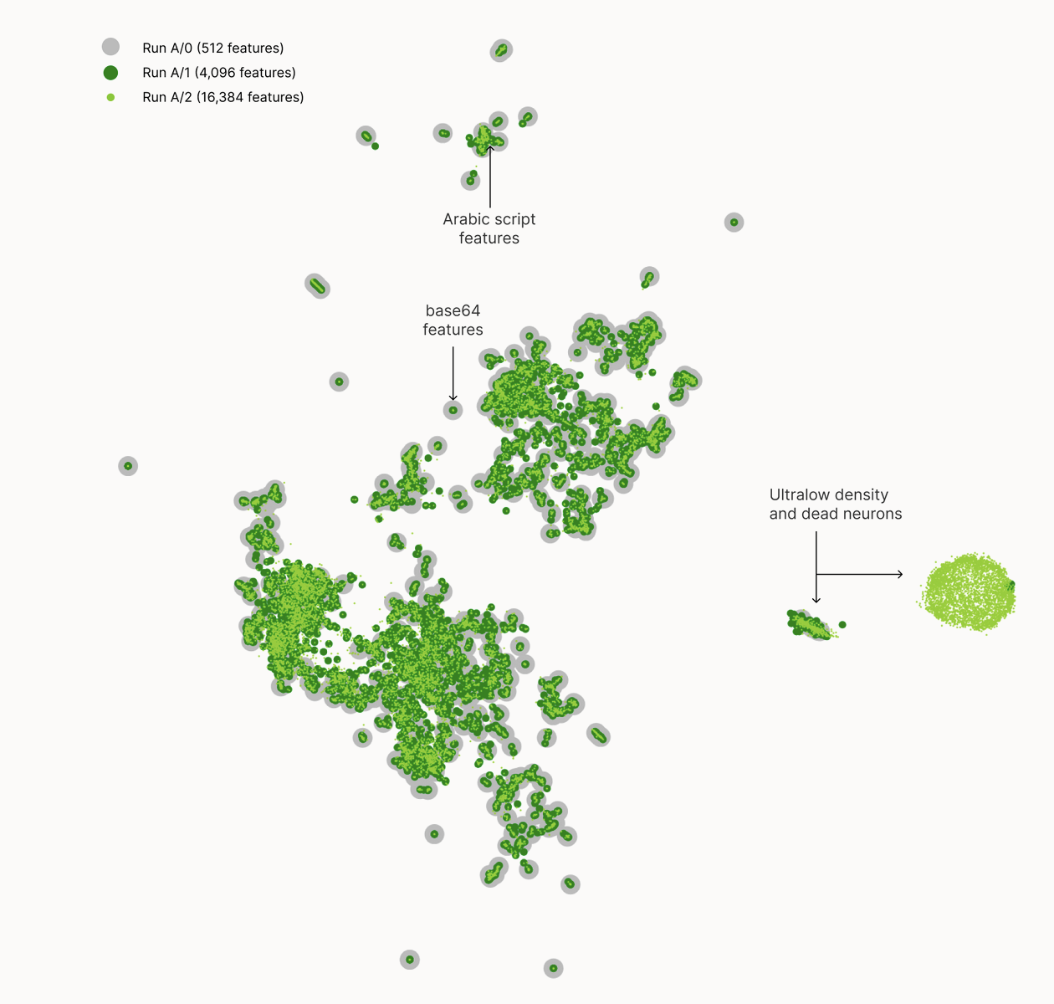
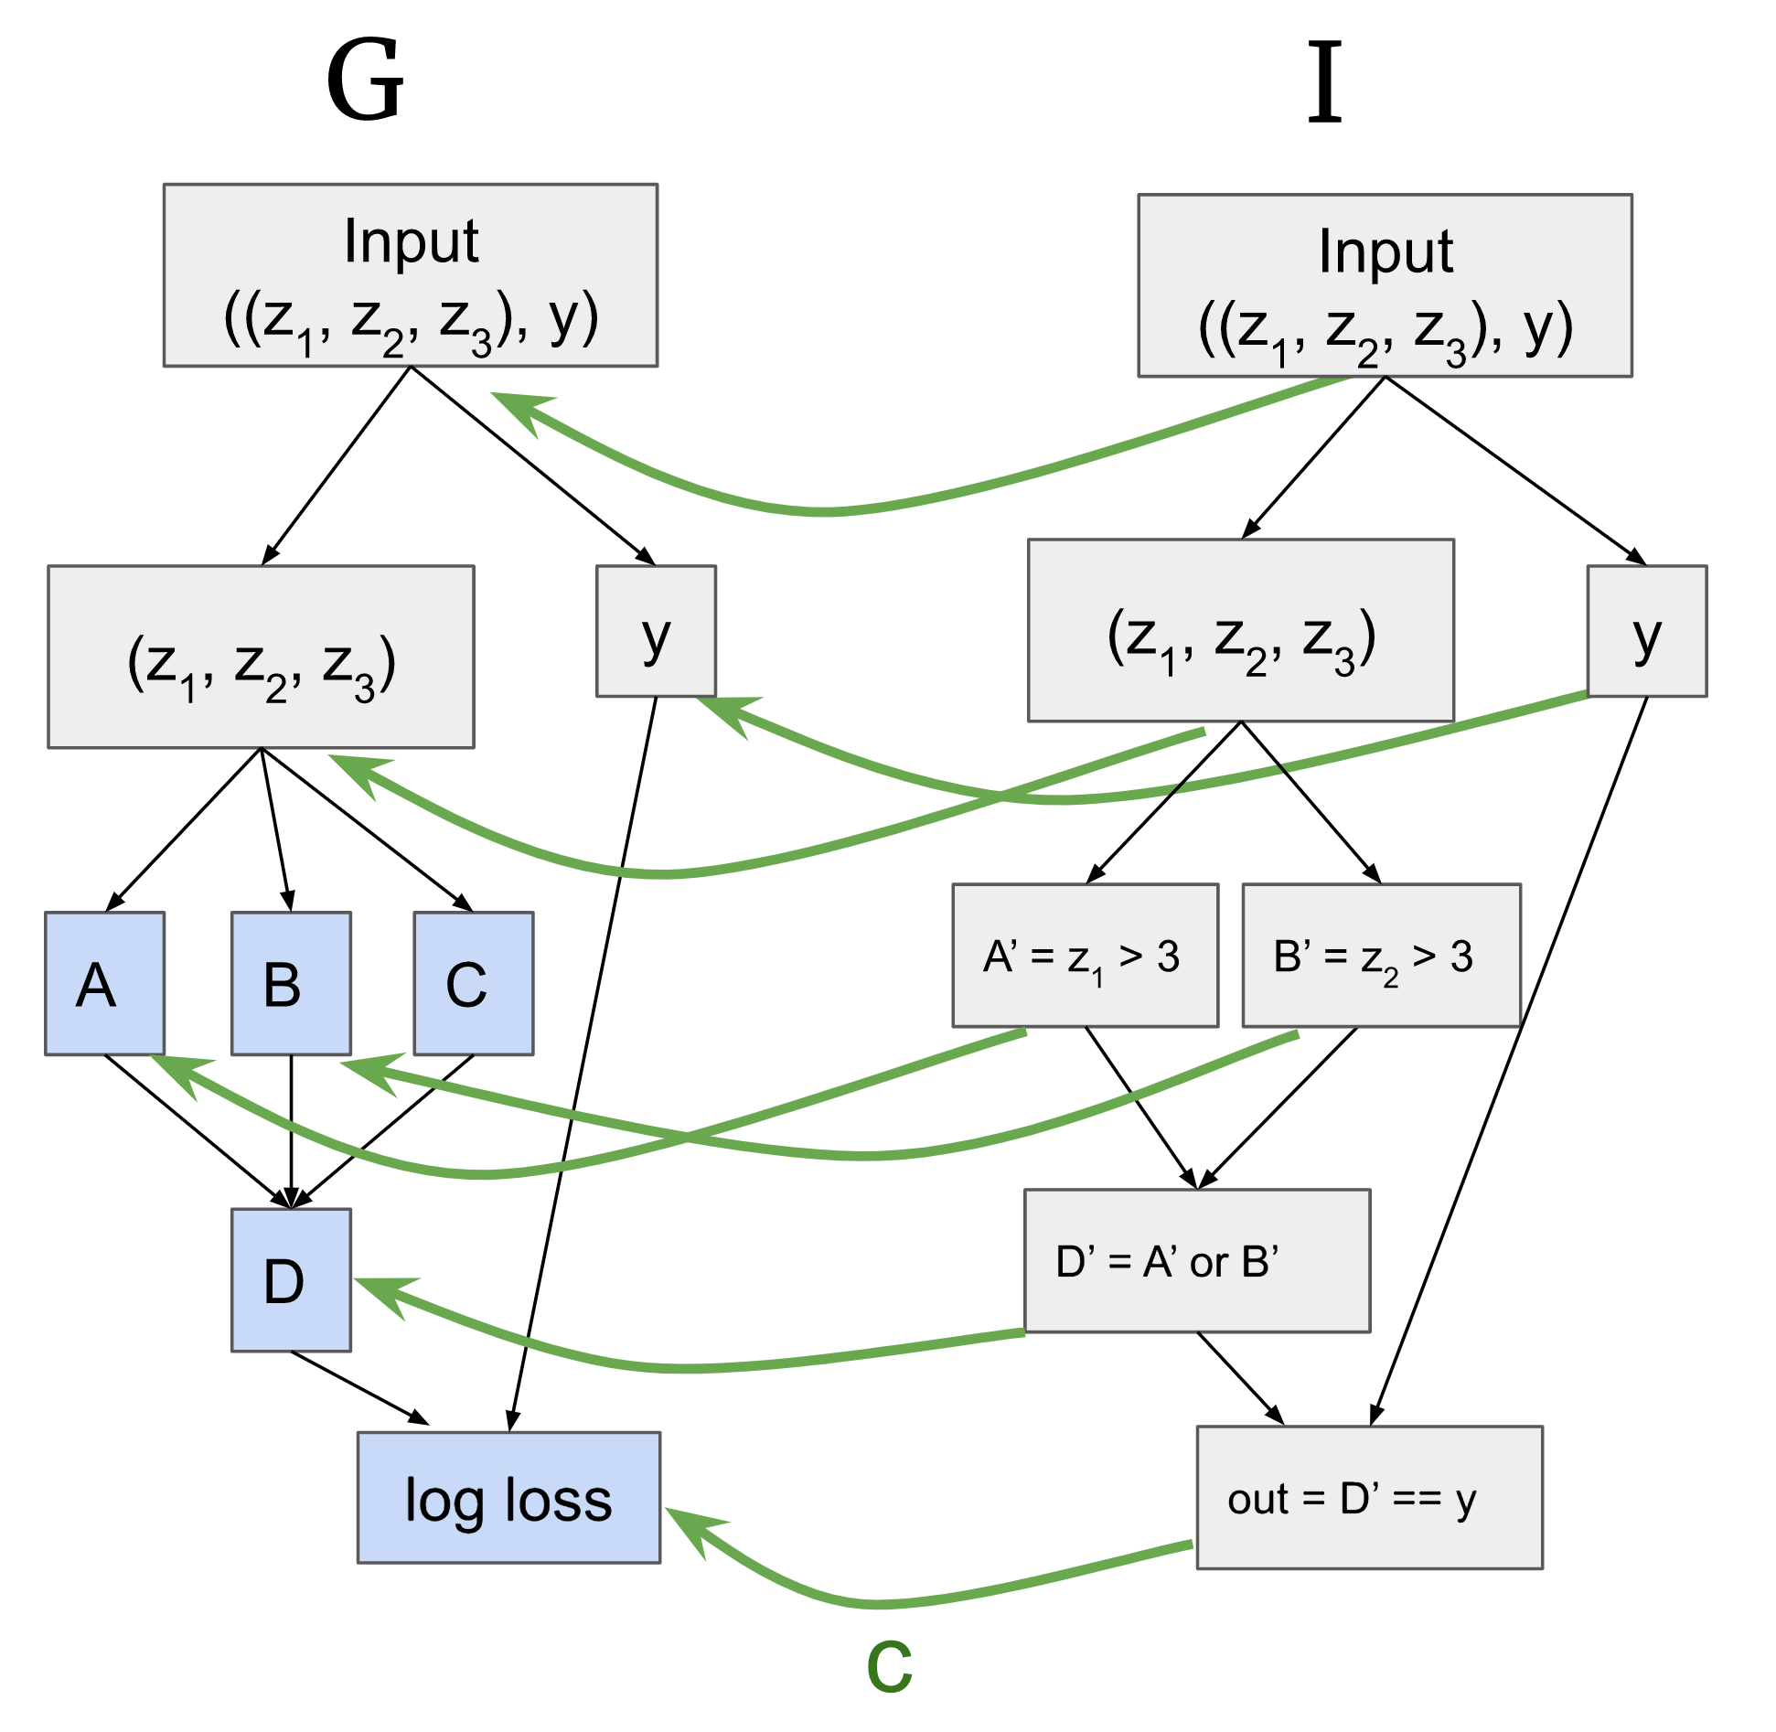
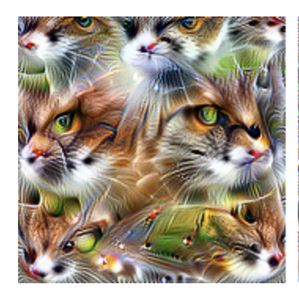
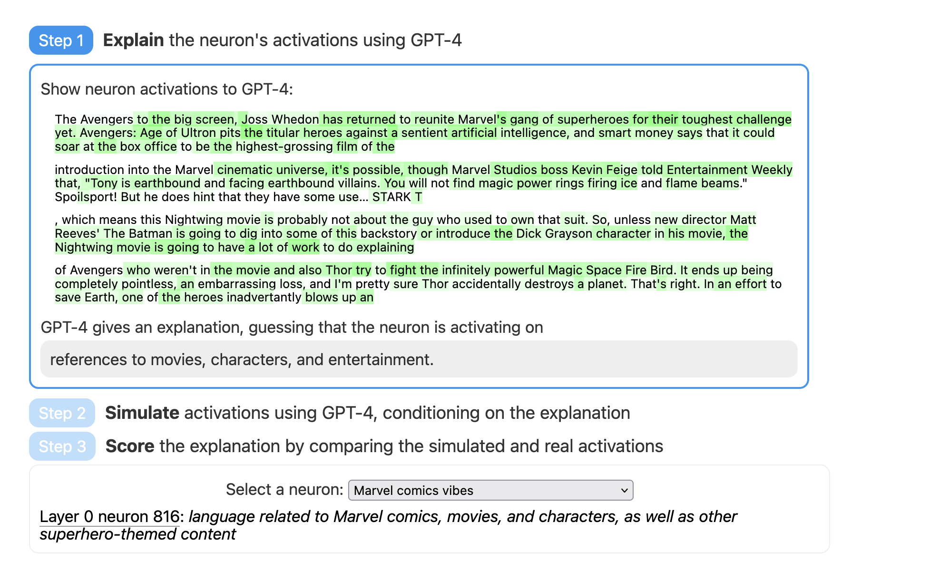
Ambitious Mechanistic Interpretability
Proofs Approach
Case Study: Max of 4
Applications: Modular Arithmetic and SAE
What we can contribute to SOTA
Manual mech interp: where should we spend our research budget?
SAEs: how do we reduce the dependence on human judgment?
GPT explains GPT: we’re hoping to use LLMs to formalize proofs
Causal Scrubbing: we add rigor and a compression metric

Slide 20
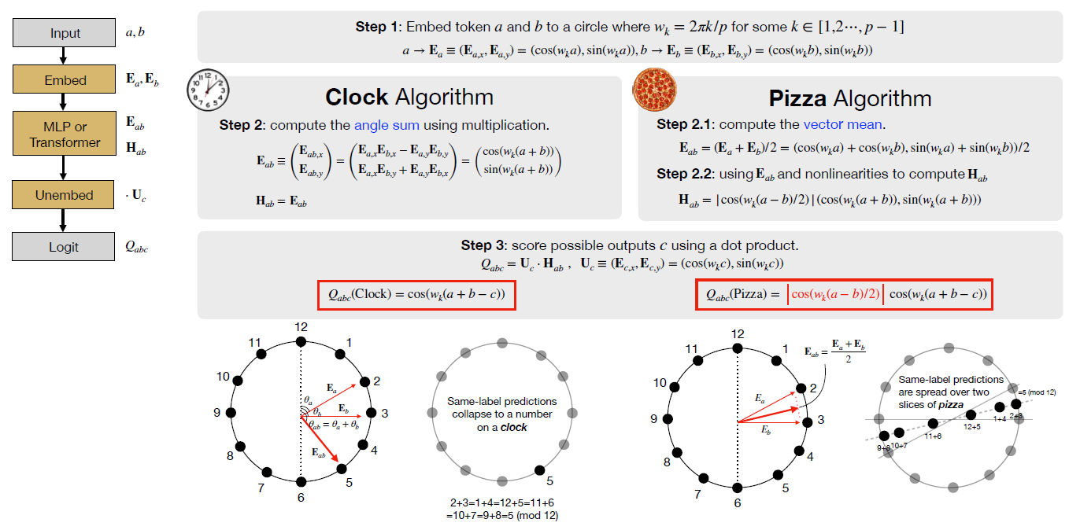
Ambitious Mechanistic Interpretability
Proofs Approach
Case Study: Max of 4
Applications: Modular Arithmetic and SAE
Modular Arithmetic Interpretability
Image from [2306.17844] The Clock and the Pizza: Two Stories in Mechanistic Explanation of Neural Networks
https://www.neelnanda.io/grokking-paper

Slide 21
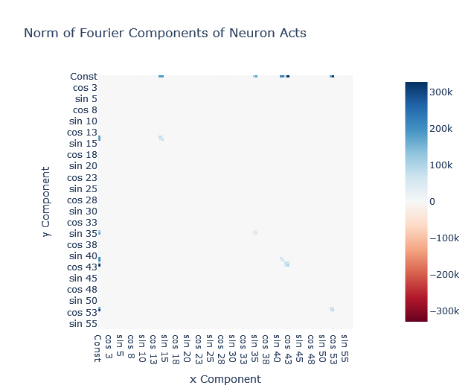
Ambitious Mechanistic Interpretability
Proofs Approach
Case Study: Max of 4
Applications: Modular Arithmetic and SAE
Budget 𝒪(p²d_mlp + p³)
We need 𝒪(p² d_mlp) just to multiply all the matrices
With this budget, we can compute everything except the MLP noise by brute force
The only interp is “unembed is low-rank”
“2D fourier basis” ⇒ requires 𝒪(p² d_computation) to validate
https://colab.research.google.com/drive/1F6_1_cWXE5M7WocUcpQWp3v8z4b1jL20#scrollTo=UuI6zMAxjU1l&line=1&uniqifier=1

Slide 22
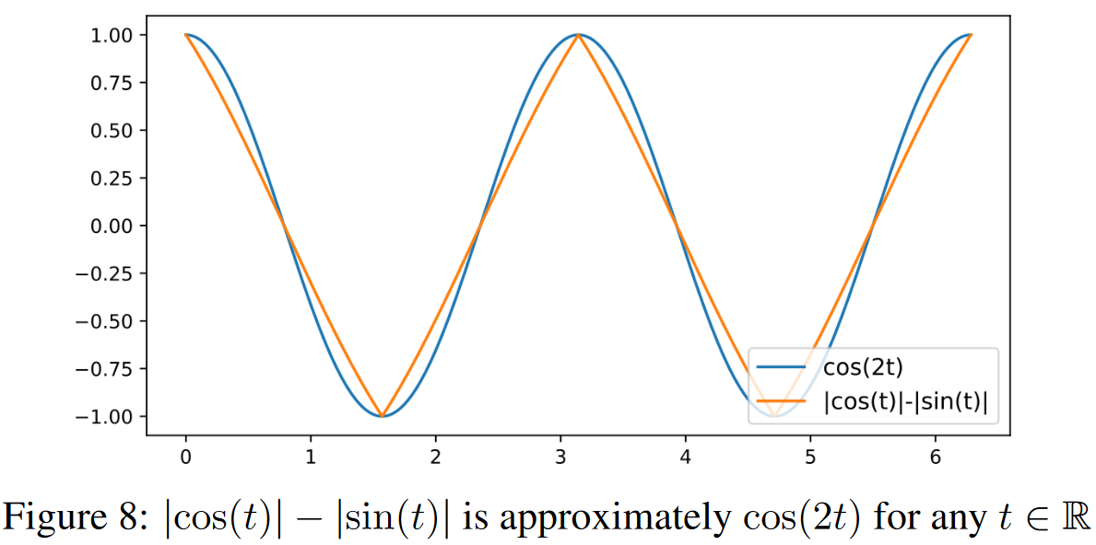
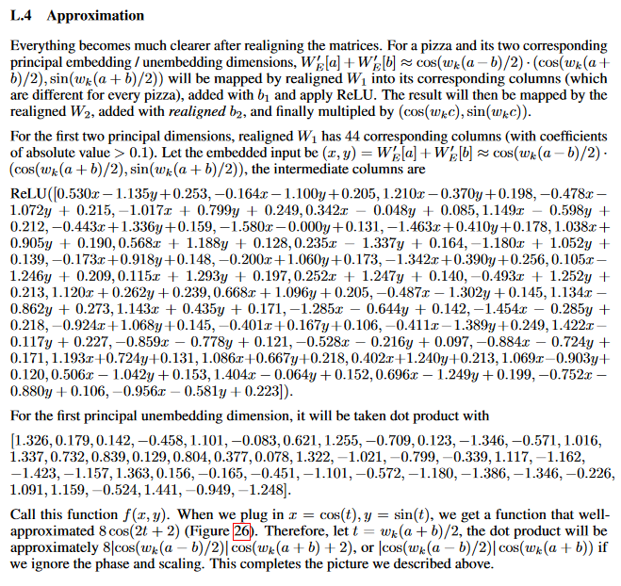
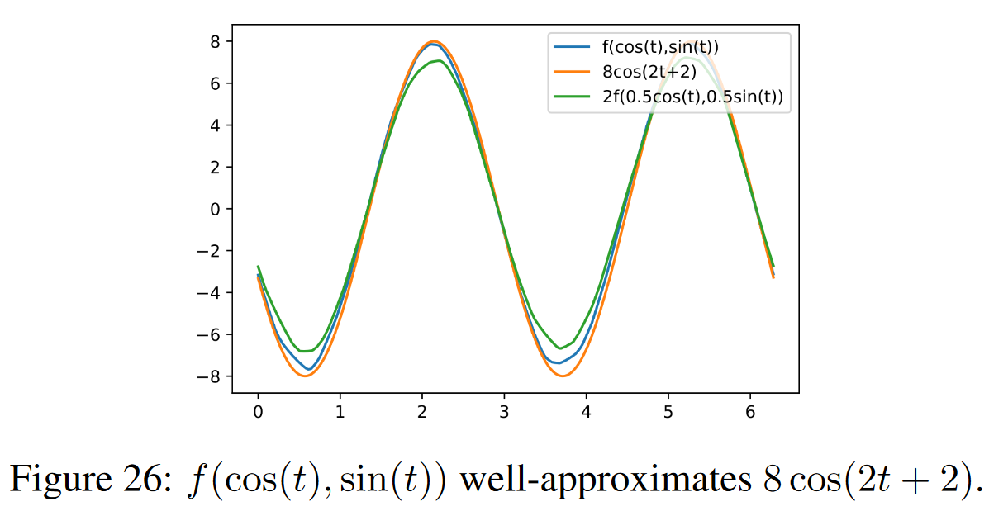
Ambitious Mechanistic Interpretability
Proofs Approach
Case Study: Max of 4
Applications: Modular Arithmetic and SAE
Explaining Pizza MLP in 𝒪(p d_mlp)
Enough to brute force the MLP behavior (w/o noise)
[2306.17844] The Clock and the Pizza: Two Stories in Mechanistic Explanation of Neural Networks

Slide 23
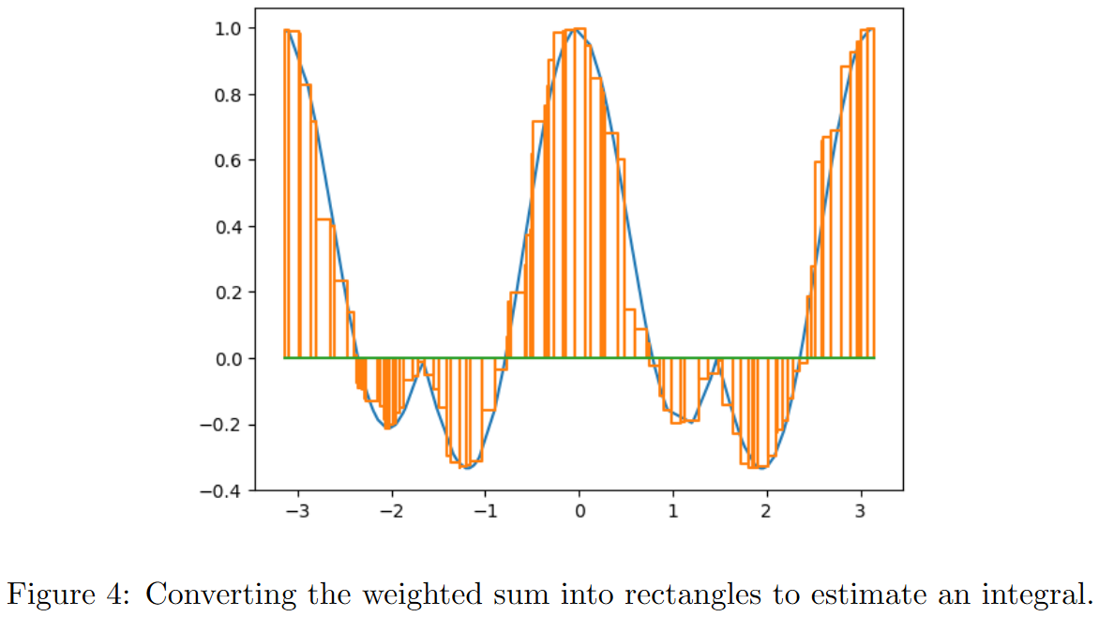
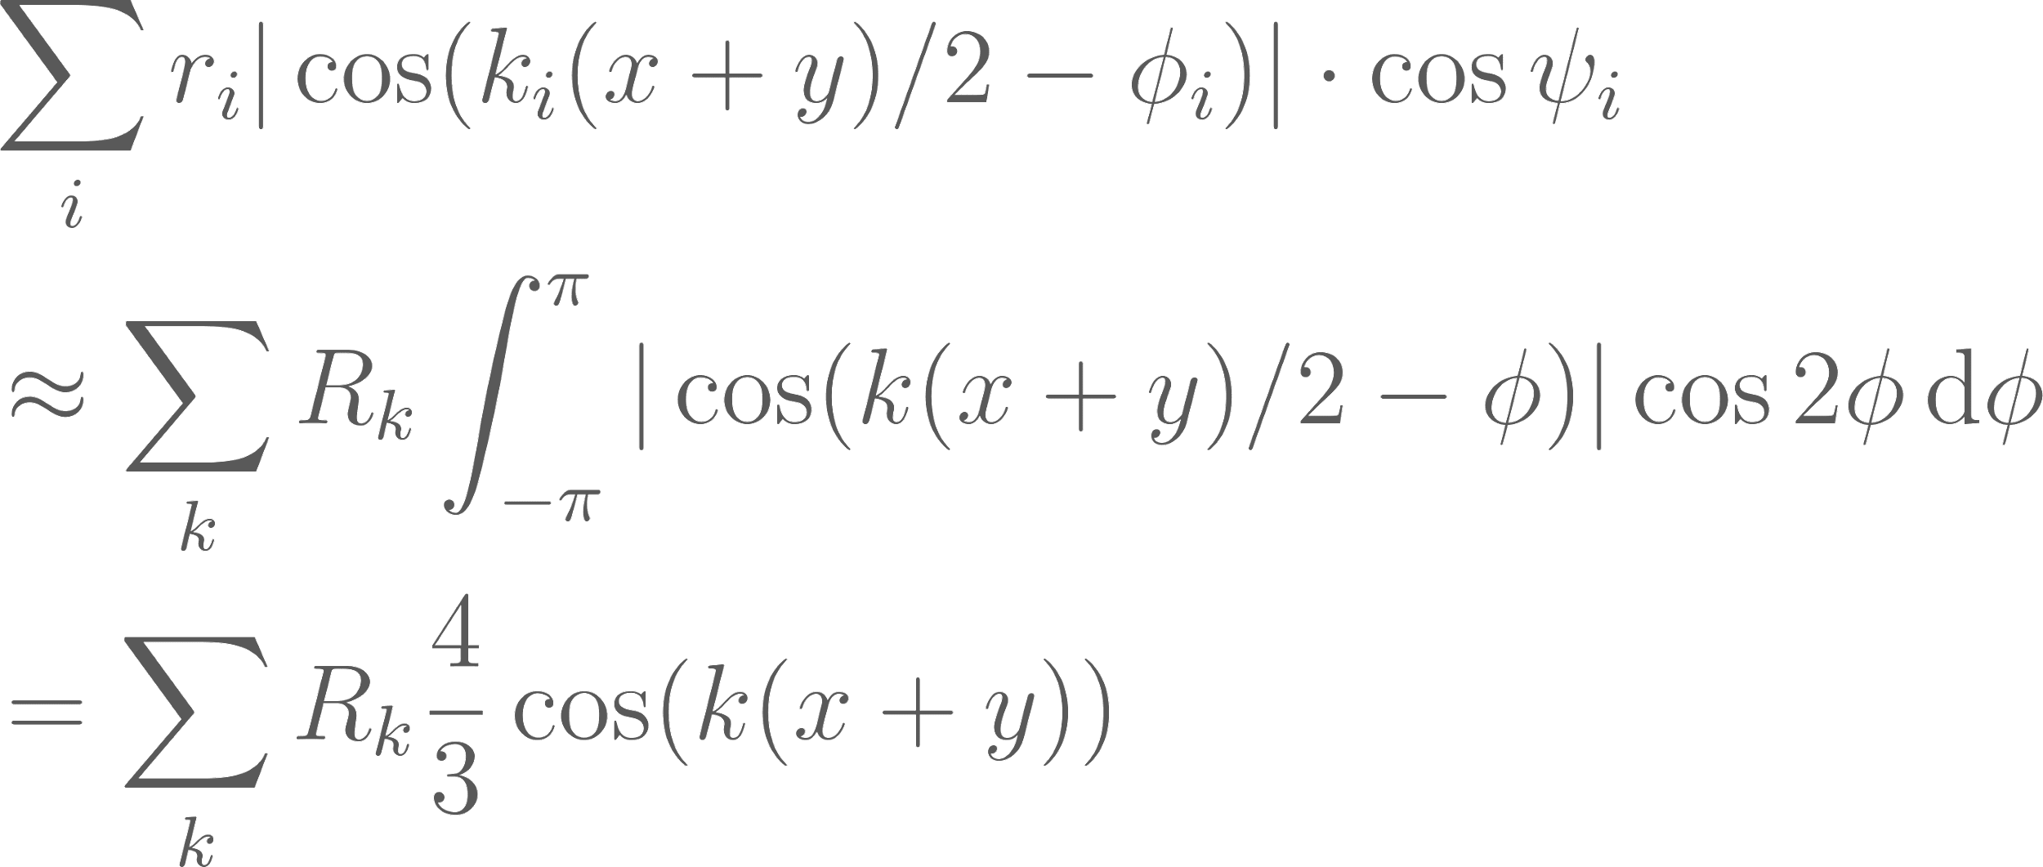
Ambitious Mechanistic Interpretability
Proofs Approach
Case Study: Max of 4
Applications: Modular Arithmetic and SAE
Budget 𝒪(p + d_mlp): Numerical Integration
sublinear in total parameter count ⇒ explanation w/ understanding
𝒪(p + d_mlp) bounds ⇒ evidence that numerical integration is “what’s really going on”
Absolute error: 0.6 (vs 0.05 empirical error; vs 0.85 baseline using uniform 0)
Inability to reduce error ⇒ lacking understanding (how to align & scale intervals)

Slide 24
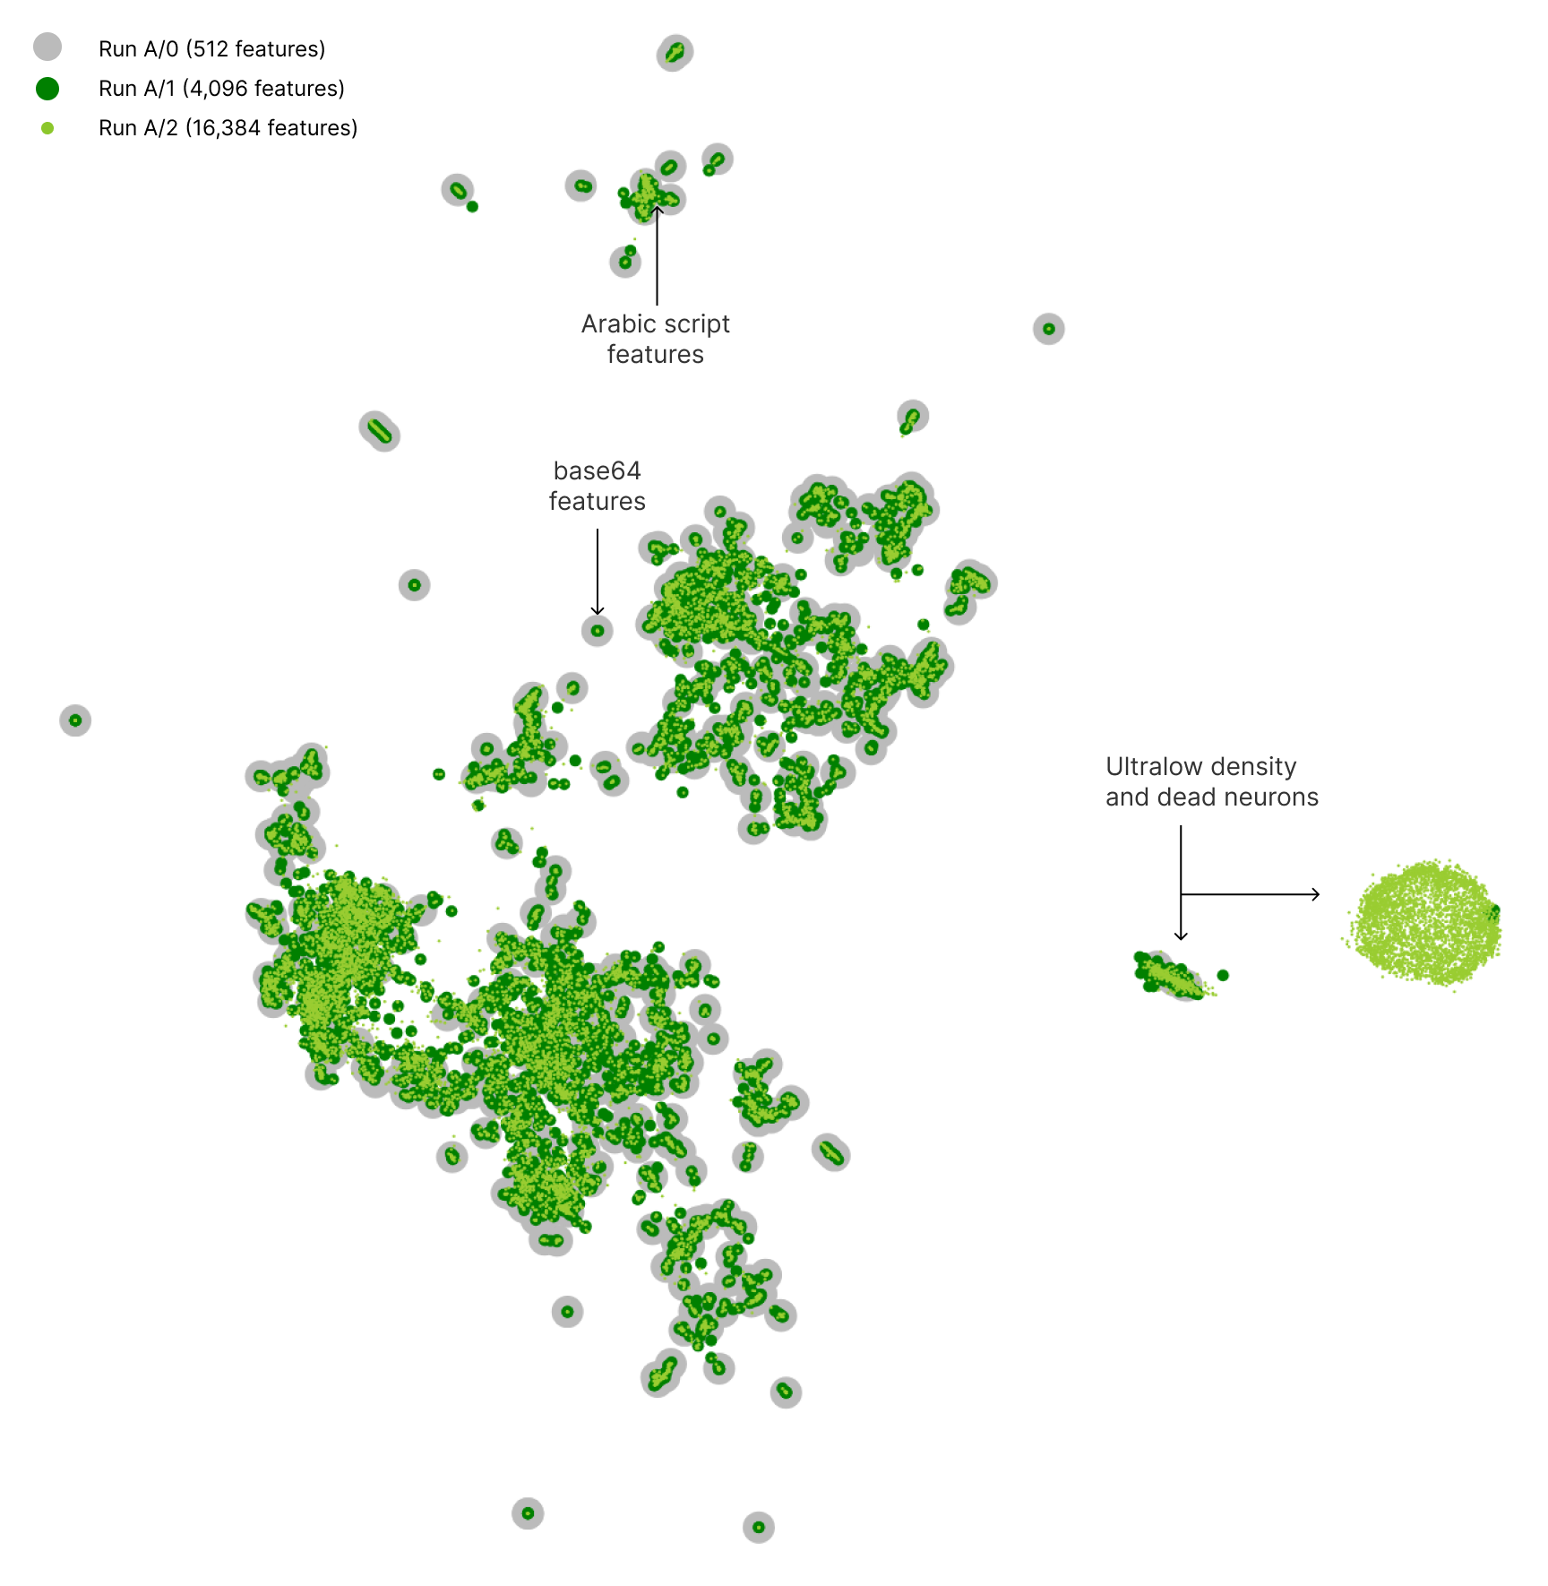
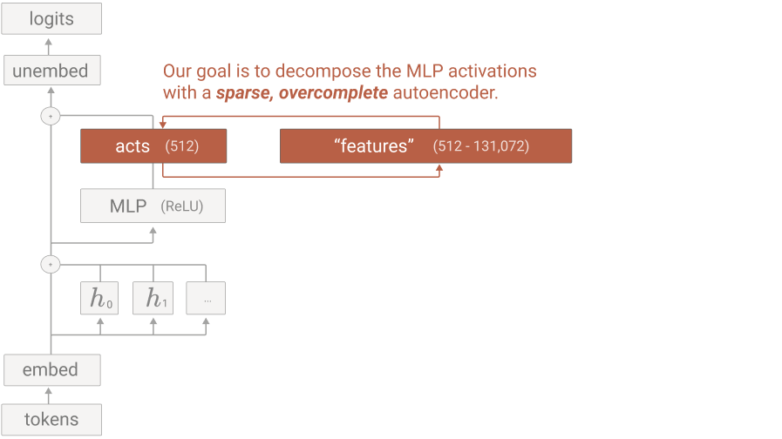
Ambitious Mechanistic Interpretability
Proofs Approach
Case Study: Max of 4
Applications: Modular Arithmetic and SAE
Sparsity Penalty in SAEs
Images from https://transformer-circuits.pub/2023/monosemantic-features

Slide 25
Ambitious Mechanistic Interpretability
Proofs Approach
Case Study: Max of 4
Applications: Modular Arithmetic and SAE
Too much human labor
…
https://transformer-circuits.pub/2024/feb-update/index.html#dict-learning-tanh
…
…
https://transformer-circuits.pub/2023/monosemantic-features/index.html#setup-autoencoder
Notes:
We found that autoencoders trained with a tanh penalty were a Pareto improvement in the space of L0 and loss recovered, often by a wide margin. Unfortunately, we found that the features in these autoencoders were much harder to interpret.
Unfortunately, this total information did not generally correlate with subjective feature interpretability or activation sparsity. [...]
Thus we ended up using a combination of several additional metrics to guide our investigations:
Manual inspection: Do the features seem interpretable?
[...]
We think it would be very helpful if we could identify better metrics for dictionary learning solutions from sparse autoencoders trained on transformers.

Slide 26
Ambitious Mechanistic Interpretability
Proofs Approach
Case Study: Max of 4
Applications: Modular Arithmetic and SAE
Sparsity Penalty in SAEs
Current sparsity penalty: activations.abs().sum()
What do SAEs get you?
Case analysis structure in proofs
L1 norm: almost fine if downstream network decomposes additively
not remotely useful if downstream task is non-linear
Proofs-frame suggested sparsity penalty: (1 + activations.abs()).prod() or activations.abs().log1p().sum()

Slide 27
Ambitious Mechanistic Interpretability
Proofs Approach
Case Study: Max of 4
Applications: Modular Arithmetic and SAE
Sparsity Penalties in SAEs
https://tinyurl.com/sae-prod1p-colab

Slide 28
Ambitious Mechanistic Interpretability
Proofs Approach
Case Study: Max of 4
Applications: Modular Arithmetic and SAE
Limitations & Future Work
In progress:
Max of 10
Sorted list
Modular addition (including MLPs)
Induction heads (2L model)
SAEs
How to solve noise?
Lagrange multiplier on various parts of the proof
Heuristic arguments
Limitations / Future Work:
Layer norm on > 1L
Automation

Slide 29
Ambitious Mechanistic Interpretability
Proofs Approach
Case Study: Max of 4
Applications: Modular Arithmetic and SAE
Conclusions
Proofs are possible!!!!!
But really hard
Small noise is a problem (no good mechanistic understanding)
Most existing work glosses over this
Do we even want an explanation of it?
Proofs can be used as a minimalist “grounding” of mech interp
Confused about X in mech interp ⇒ convert to proof frame
Link between depth of understanding and proof length
Shorter proofs require deeper (more compressed) understanding
After improving bound tightness (fixed complexity), we can extract understanding
Failure to compact proof ⇒ lack mechanistic understanding
Objective, numerical standard for understanding
Can be tailored to subcomponents

